Slide 1
Networks
Shortest Paths and Minimum Spanning Tree (MST)

Slide 2
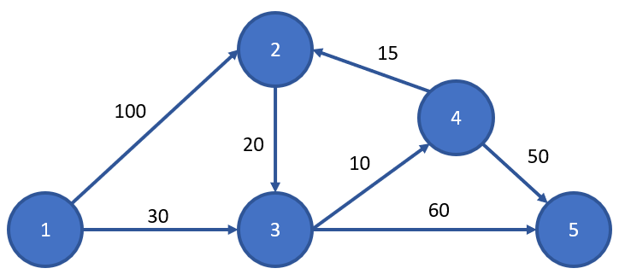
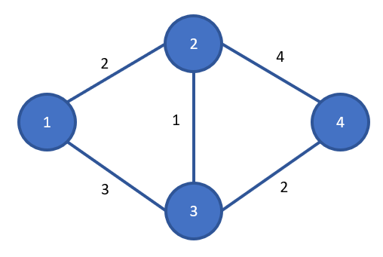
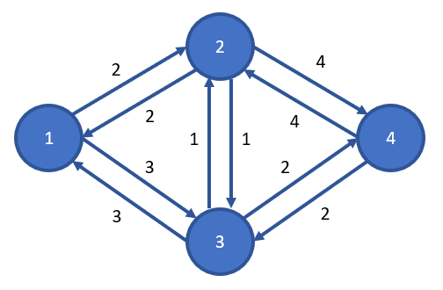
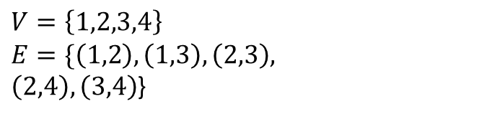
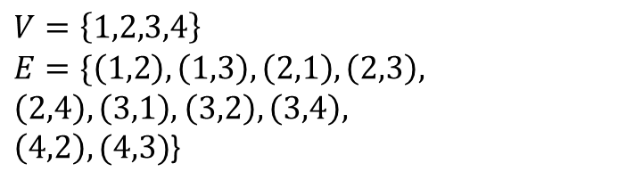
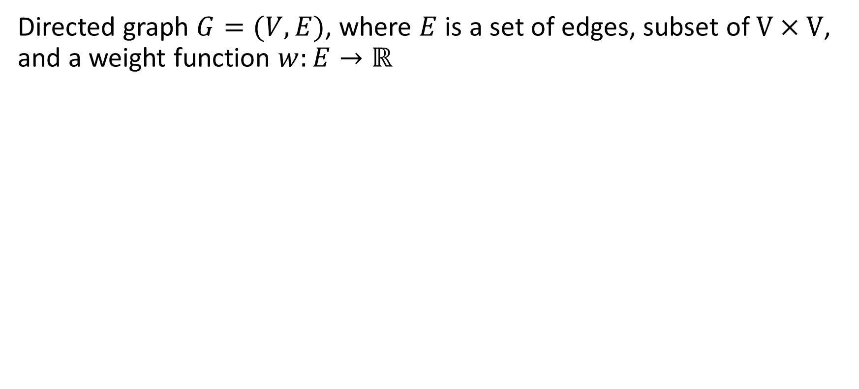
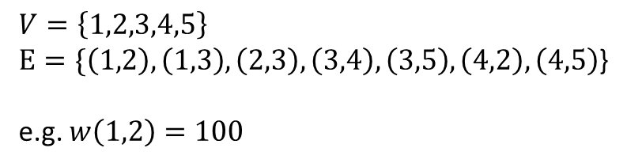
Network
Directed graph $G=(V,E)$, where $E$ is a set of edges, subset of $V×V$, and a weight function $w:E→ℝ$
$V=\left\{1,2,3,4,5\right\}$
$E=\{\left(1,2\right),\left(1,3\right),\left(2,3\right),\left(3,4\right),\left(3,5\right),\left(4,2\right),\left(4,5\right)$}
e.g. $w\left(1,2\right)=100$
$V=\left\{1,2,3,4\right\}$
$$E=\{\left(1,2\right),\left(1,3\right),\left(2,3\right),$$
$\left(2,4\right), \left(3,4\right)$}
$V=\left\{1,2,3,4\right\}$
$$E=\{\left(1,2\right),\left(1,3\right),\left(2,1\right),\left(2,3\right),$$
$\left(2,4\right),\left(3,1\right),$ $\left(3,2\right), \left(3,4\right),$
$\left(4,2\right),(4,3)$}

Slide 3

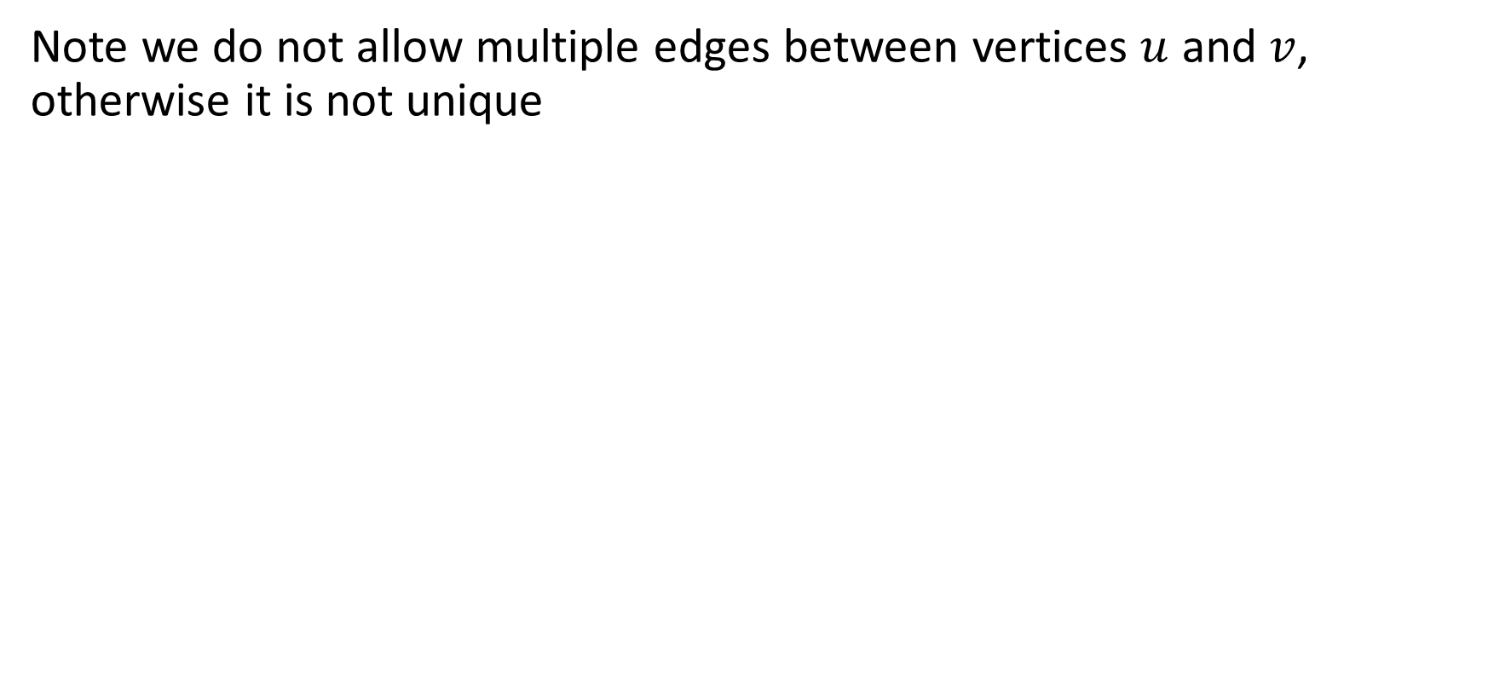
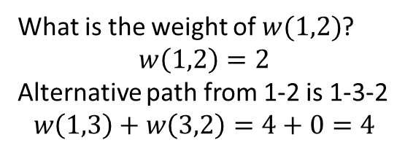
Network
Note we do not allow multiple edges between vertices $u$ and $v$, otherwise the edge weight would not be well defined
2
2
2
1
0
4
3
1
2
4
What is $w(1,2)$?
What is $w(1,2)$?
$$w\left(1,2\right)=2$$
Alternative path from 1-2 is 1-3-2
$$w\left(1,3\right)+w\left(3,2\right)=4+0=4$$

Slide 4
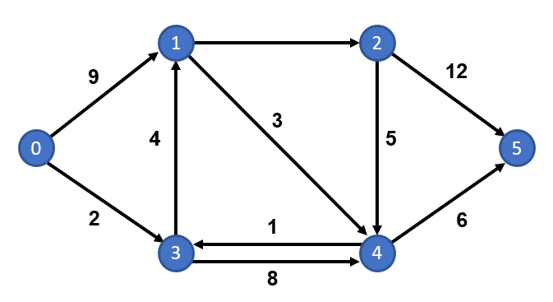
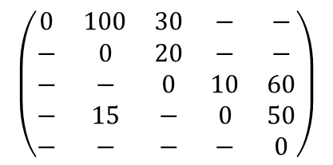
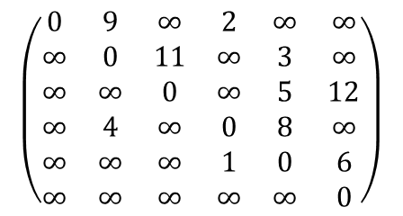
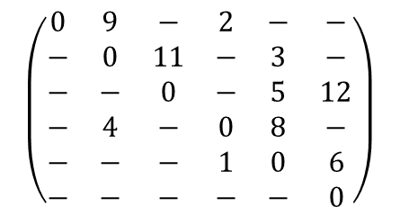
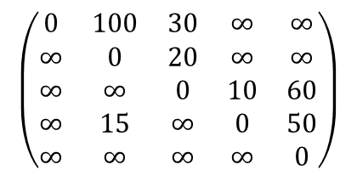
Adjacency Matrix
We won’t have direct use for this, but it is worth noting!
11
$$\left(\begin{matrix}0 & 100 & 30 & − & − \\ − & 0 & 20 & − & − \\ − & − & 0 & 10 & 60 \\ − & 15 & − & 0 & 50 \\ − & − & − & − & 0\end{matrix}\right)$$
$$\left(\begin{matrix}0 & 100 & 30 & ∞ & ∞ \\ ∞ & 0 & 20 & ∞ & ∞ \\ ∞ & ∞ & 0 & 10 & 60 \\ ∞ & 15 & ∞ & 0 & 50 \\ ∞ & ∞ & ∞ & ∞ & 0\end{matrix}\right)$$
$$\left(\begin{matrix}0 & 9 & − & 2 & − & − \\ − & 0 & 11 & − & 3 & − \\ − & − & 0 & − & 5 & 12 \\ − & 4 & − & 0 & 8 & − \\ − & − & − & 1 & 0 & 6 \\ − & − & − & − & − & 0\end{matrix}\right)$$
$$\left(\begin{matrix}0 & 9 & ∞ & 2 & ∞ & ∞ \\ ∞ & 0 & 11 & ∞ & 3 & ∞ \\ ∞ & ∞ & 0 & ∞ & 5 & 12 \\ ∞ & 4 & ∞ & 0 & 8 & ∞ \\ ∞ & ∞ & ∞ & 1 & 0 & 6 \\ ∞ & ∞ & ∞ & ∞ & ∞ & 0\end{matrix}\right)$$
OR
OR

Slide 5
Shortest Path Problem
Definition: Find the shortest path between two vertices (source and destination) such that the sum of the weights of its edges is minimised.
Perhaps one of the most fundamental problems in Mathematics and Computer Science
Huge implications on routing and traffic problems, e.g. vehicular, telecommunications.
If you’ve used Google Maps, you’ve asked to solve a form of shortest path problem!

Slide 6
Blue Peter Example
11
1
2
9
12
3
0
4
5
5
2
1
6
3
4
8
Shortest path between 0 and 5 is 0-3-1-4-5 of length 15

Slide 7
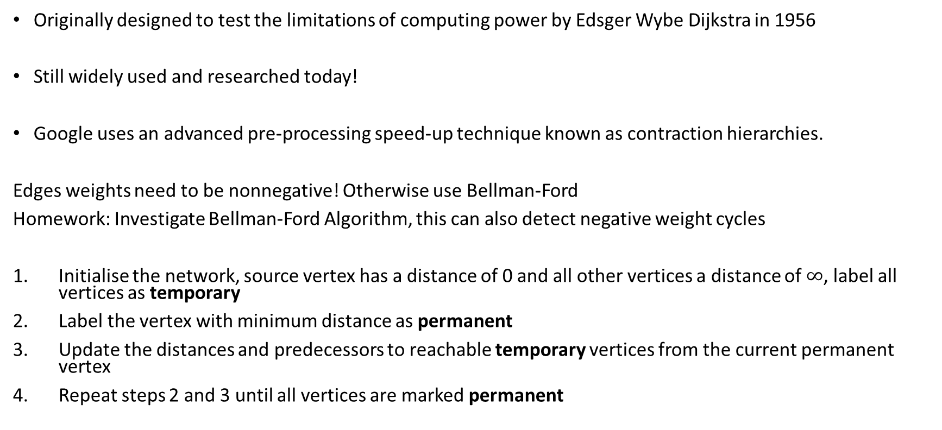
Dijkstra’s Algorithm
Designed by Edsger Wybe Dijkstra in 1956 (published 1959) to demonstrate the new ARMAC computer
Still widely used and researched today!
Route planners use pre-processing speed-up techniques such as contraction hierarchies.
Edge weights need to be nonnegative! Otherwise use Bellman-Ford
Homework: Investigate Bellman-Ford Algorithm, this can also detect negative weight cycles
Initialise the network, source vertex has a distance of 0 and all other vertices a distance of $∞$, label all vertices as temporary
Label the vertex with minimum distance as permanent
Update the distances and predecessors to reachable temporary vertices from the current permanent vertex
Repeat steps 2 and 3 until all vertices are marked permanent

Slide 8

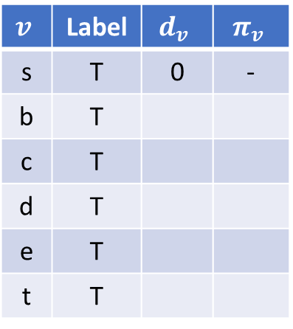

Set Up
$$v$$
Permanent
$$v$$
Temporary
-
-
∞
∞
11
$$v$$ | Label | $$d_{v}$$ | $$π_{v}$$
s | T | 0 | -
b | T
c | T
d | T
e | T
t | T
b
c
9
12
-
3
-
0
s
4
5
t
∞
2
1
6
d
e
8
∞
∞
-
-
Initialise the network, source vertex has a distance of 0 and all other vertices a distance of $∞$

Slide 9

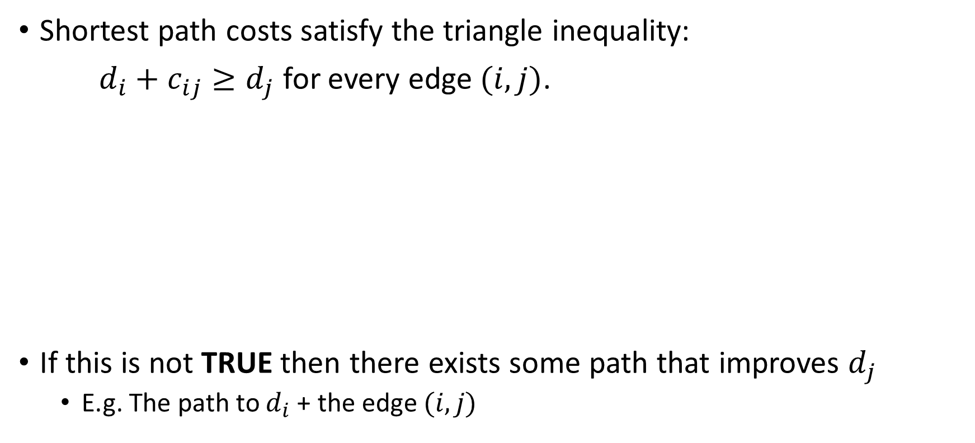


Improving Cost Labels
Shortest path costs satisfy the triangle inequality:
$d_{i}+c_{ij}≥d_{j}$ for every edge $(i, j)$.
If this is not TRUE then there exists some path that improves $d_{j}$
  E.g. the shortest path to $i$ followed by the edge $(i,j)$
$$d_{i}$$
x
y
i
$$c_{ij}$$
z
x + y ≥ z
s
j
$$d_{j}$$

Slide 10
Dijkstra Example
$$v$$
Permanent
$$v$$
Temporary
-
-
∞
∞
11
$$v$$ | Label | $$d_{v}$$ | $$π_{v}$$
s | T | 0 | -
b | T
c | T
d | T
e | T
t | T
b
c
9
12
-
3
-
0
s
4
5
t
∞
2
1
6
d
e
8
∞
∞
-
-
Initialise the network, source vertex has a distance of 0 and all other vertices a distance of $∞$

Slide 11
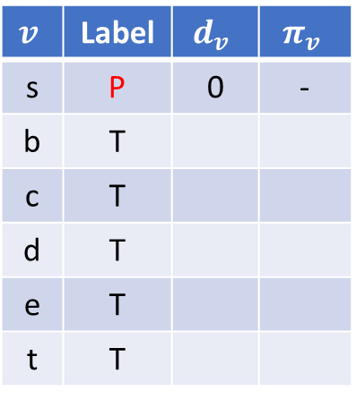
Example
$$v$$
Permanent
$$v$$
Temporary
-
-
∞
∞
11
$$v$$ | Label | $$d_{v}$$ | $$π_{v}$$
s | P | 0 | -
b | T
c | T
d | T
e | T
t | T
b
c
9
12
-
3
-
0
s
4
5
t
∞
2
1
6
d
e
8
∞
∞
-
-
Label temporary vertex with minimum distance as permanent

Slide 12
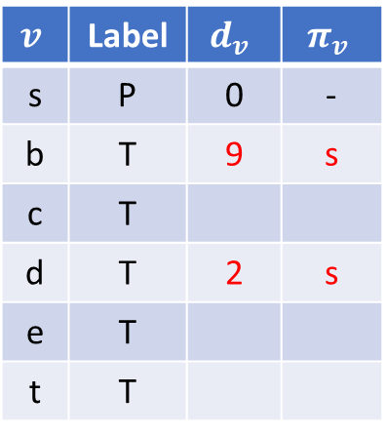
Example
$$v$$
Permanent
$$v$$
Temporary
s
-
9
∞
11
$$v$$ | Label | $$d_{v}$$ | $$π_{v}$$
s | P | 0 | -
b | T | 9 | s
c | T
d | T | 2 | s
e | T
t | T
0+9=9
b
c
9
12
-
3
-
0
s
4
5
t
∞
2
1
6
0+2=2
d
e
8
2
∞
s
-
Update distances to reachable vertices which are labelled temporary

Slide 13
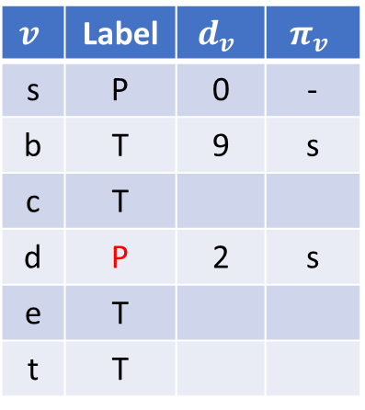
Example
$$v$$
Permanent
$$v$$
Temporary
s
-
9
∞
11
$$v$$ | Label | $$d_{v}$$ | $$π_{v}$$
s | P | 0 | -
b | T | 9 | s
c | T
d | P | 2 | s
e | T
t | T
b
c
9
12
-
3
-
0
s
4
5
t
∞
2
1
6
d
e
8
2
∞
s
-
Label temporary vertex with minimum distance as permanent

Slide 14
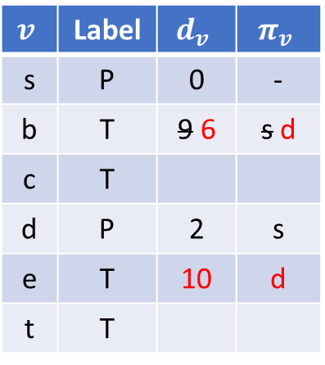
Example
$$v$$
Permanent
$$v$$
Temporary
d
-
6
∞
11
$$v$$ | Label | $$d_{v}$$ | $$π_{v}$$
s | P | 0 | -
b | T | 9 6 | s d
c | T
d | P | 2 | s
e | T | 10 | d
t | T
b
c
9
12
-
3
-
0
s
4
2+4=6
5
t
∞
2
1
6
d
e
8
2
10
2+8=10
s
d
Update distances to reachable vertices which are labelled temporary

Slide 15
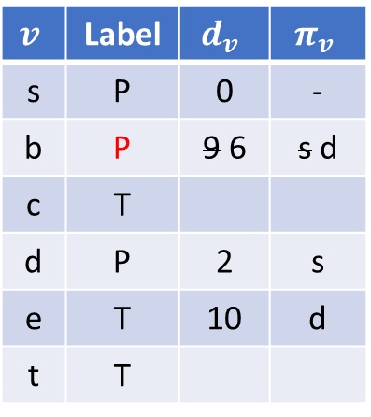
Example
$$v$$
Permanent
$$v$$
Temporary
d
-
6
∞
11
$$v$$ | Label | $$d_{v}$$ | $$π_{v}$$
s | P | 0 | -
b | P | 9 6 | s d
c | T
d | P | 2 | s
e | T | 10 | d
t | T
b
c
9
12
-
3
-
0
s
4
5
t
∞
2
1
6
d
e
8
2
10
s
d
Label temporary vertex with minimum distance as permanent

Slide 16
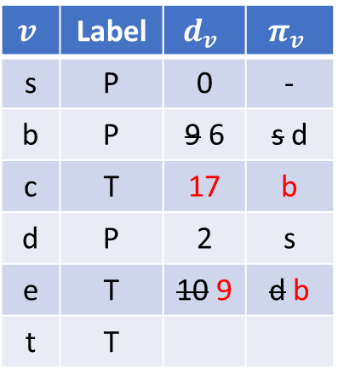
Example
$$v$$
Permanent
$$v$$
Temporary
d
6+11=17
b
6
17
11
$$v$$ | Label | $$d_{v}$$ | $$π_{v}$$
s | P | 0 | -
b | P | 9 6 | s d
c | T | 17 | b
d | P | 2 | s
e | T | 10 9 | d b
t | T
b
c
9
12
-
3
-
4
6+3=9
5
0
s
t
∞
2
1
6
d
e
8
2
9
s
b
Update distances to reachable vertices which are labelled temporary

Slide 17
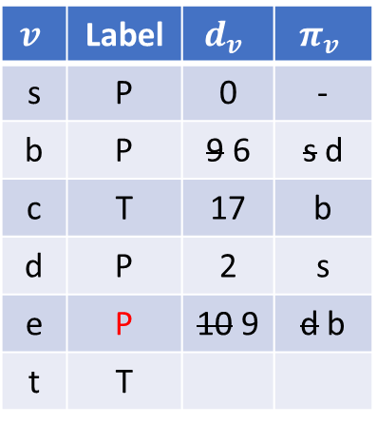
Example
$$v$$
Permanent
$$v$$
Temporary
d
b
6
17
11
$$v$$ | Label | $$d_{v}$$ | $$π_{v}$$
s | P | 0 | -
b | P | 9 6 | s d
c | T | 17 | b
d | P | 2 | s
e | P | 10 9 | d b
t | T
b
c
9
12
-
3
-
0
s
4
5
t
∞
2
1
6
d
e
8
2
9
s
b
Label temporary vertex with minimum distance as permanent

Slide 18
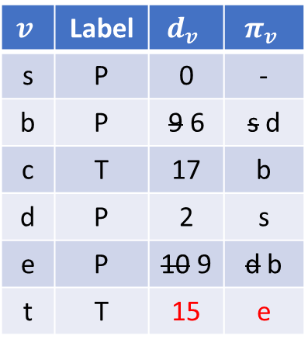
Example
$$v$$
Permanent
$$v$$
Temporary
d
b
6
17
11
$$v$$ | Label | $$d_{v}$$ | $$π_{v}$$
s | P | 0 | -
b | P | 9 6 | s d
c | T | 17 | b
d | P | 2 | s
e | P | 10 9 | d b
t | T | 15 | e
b
c
9
12
-
3
e
0
s
4
5
t
15
2
1
6
d
e
9+6=15
8
2
9
s
b
Update distances to reachable vertices which are labelled temporary

Slide 19
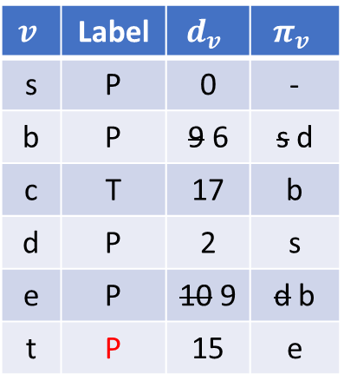
Example
$$v$$
Permanent
$$v$$
Temporary
d
b
6
17
11
$$v$$ | Label | $$d_{v}$$ | $$π_{v}$$
s | P | 0 | -
b | P | 9 6 | s d
c | T | 17 | b
d | P | 2 | s
e | P | 10 9 | d b
t | P | 15 | e
b
c
9
12
-
3
e
0
s
4
5
t
15
2
1
6
d
e
8
2
9
s
b
Label temporary vertex with minimum distance as permanent

Slide 20
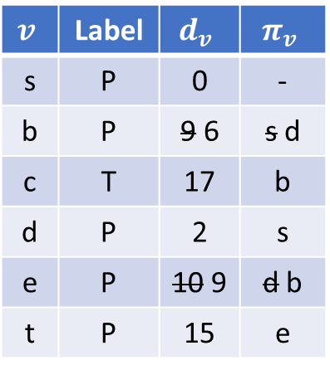
Example
$$v$$
Permanent
$$v$$
Temporary
d
b
6
17
11
$$v$$ | Label | $$d_{v}$$ | $$π_{v}$$
s | P | 0 | -
b | P | 9 6 | s d
c | T | 17 | b
d | P | 2 | s
e | P | 10 9 | d b
t | P | 15 | e
b
c
9
12
-
3
e
0
s
4
5
t
15
2
1
6
d
e
8
2
9
s
b
Update distances to reachable vertices which are labelled temporary. No changes

Slide 21
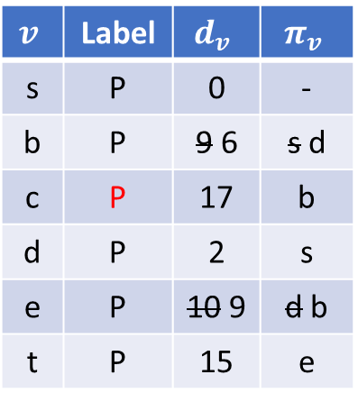
Example
$$v$$
Permanent
$$v$$
Temporary
d
b
6
17
11
$$v$$ | Label | $$d_{v}$$ | $$π_{v}$$
s | P | 0 | -
b | P | 9 6 | s d
c | P | 17 | b
d | P | 2 | s
e | P | 10 9 | d b
t | P | 15 | e
b
c
9
12
-
3
e
0
s
4
5
t
15
2
1
6
d
e
8
2
9
s
b
Label temporary vertex with minimum distance as permanent

Slide 22
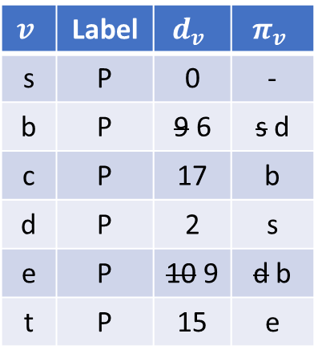
Example
$$v$$
Permanent
$$v$$
Temporary
d
b
6
17
11
17+12=29
$$v$$ | Label | $$d_{v}$$ | $$π_{v}$$
s | P | 0 | -
b | P | 9 6 | s d
c | P | 17 | b
d | P | 2 | s
e | P | 10 9 | d b
t | P | 15 | e
b
c
9
12
-
3
e
0
s
4
5
t
15
17+5=22
2
1
6
d
e
8
2
9
s
b
Update distances to reachable vertices which are labelled temporary. No changes

Slide 23
Example
$$v$$
Permanent
$$v$$
Temporary
d
b
6
17
11
$$v$$ | Label | $$d_{v}$$ | $$π_{v}$$
s | P | 0 | -
b | P | 9 6 | s d
c | P | 17 | b
d | P | 2 | s
e | P | 10 9 | d b
t | P | 15 | e
b
c
9
12
-
3
e
0
s
4
5
t
15
2
1
6
d
e
8
2
9
s
b
Final Network and Table

Slide 24
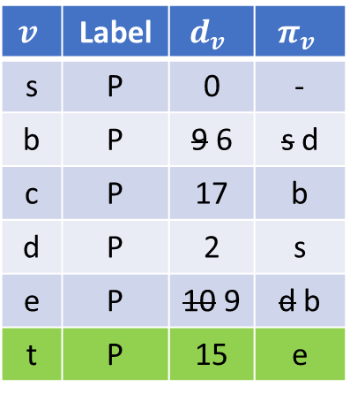
Example
$$v$$
Permanent
$$v$$
Temporary
d
b
6
17
11
$$v$$ | Label | $$d_{v}$$ | $$π_{v}$$
s | P | 0 | -
b | P | 9 6 | s d
c | P | 17 | b
d | P | 2 | s
e | P | 10 9 | d b
t | P | 15 | e
b
c
9
12
-
3
e
0
s
4
5
t
15
2
1
6
d
e
8
2
9
s
b
To compute the shortest path, work backwards from the destination t along the predecessors

Slide 25
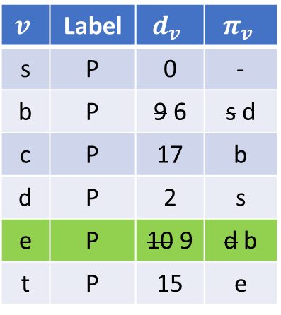
Example
$$v$$
Permanent
$$v$$
Temporary
d
b
6
17
11
$$v$$ | Label | $$d_{v}$$ | $$π_{v}$$
s | P | 0 | -
b | P | 9 6 | s d
c | P | 17 | b
d | P | 2 | s
e | P | 10 9 | d b
t | P | 15 | e
b
c
9
12
-
3
e
0
s
4
5
t
15
2
1
6
d
e
8
2
9
s
b
To compute the shortest path, work backwards from the destination t along the predecessors

Slide 26
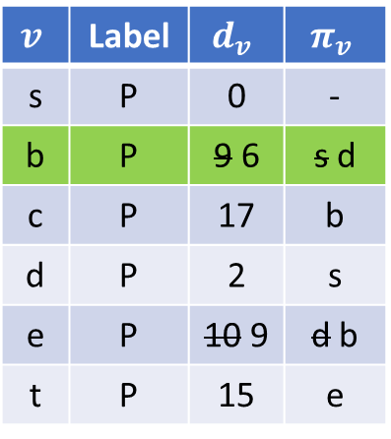
Example
$$v$$
Permanent
$$v$$
Temporary
d
b
6
17
11
$$v$$ | Label | $$d_{v}$$ | $$π_{v}$$
s | P | 0 | -
b | P | 9 6 | s d
c | P | 17 | b
d | P | 2 | s
e | P | 10 9 | d b
t | P | 15 | e
b
c
9
12
-
3
e
0
s
4
5
t
15
2
1
6
d
e
8
2
9
s
b
To compute the shortest path, work backwards from the destination t along the predecessors

Slide 27
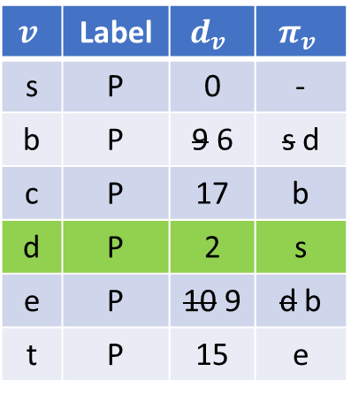
Example
$$v$$
Permanent
$$v$$
Temporary
d
b
6
17
11
$$v$$ | Label | $$d_{v}$$ | $$π_{v}$$
s | P | 0 | -
b | P | 9 6 | s d
c | P | 17 | b
d | P | 2 | s
e | P | 10 9 | d b
t | P | 15 | e
b
c
9
12
-
3
e
0
s
4
5
t
15
2
1
6
d
e
8
2
9
s
b
To compute the shortest path, work backwards from the destination t along the predecessors

Slide 28
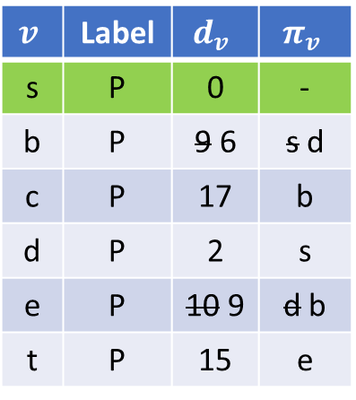
Example
$$v$$
Permanent
$$v$$
Temporary
d
b
6
17
11
$$v$$ | Label | $$d_{v}$$ | $$π_{v}$$
s | P | 0 | -
b | P | 9 6 | s d
c | P | 17 | b
d | P | 2 | s
e | P | 10 9 | d b
t | P | 15 | e
b
c
9
12
-
3
e
0
s
4
5
t
15
2
1
6
d
e
8
2
9
s
b
Shortest path from $s$ to $t$ is $s−d−b−e−t$ with a path length of $15$

Slide 29
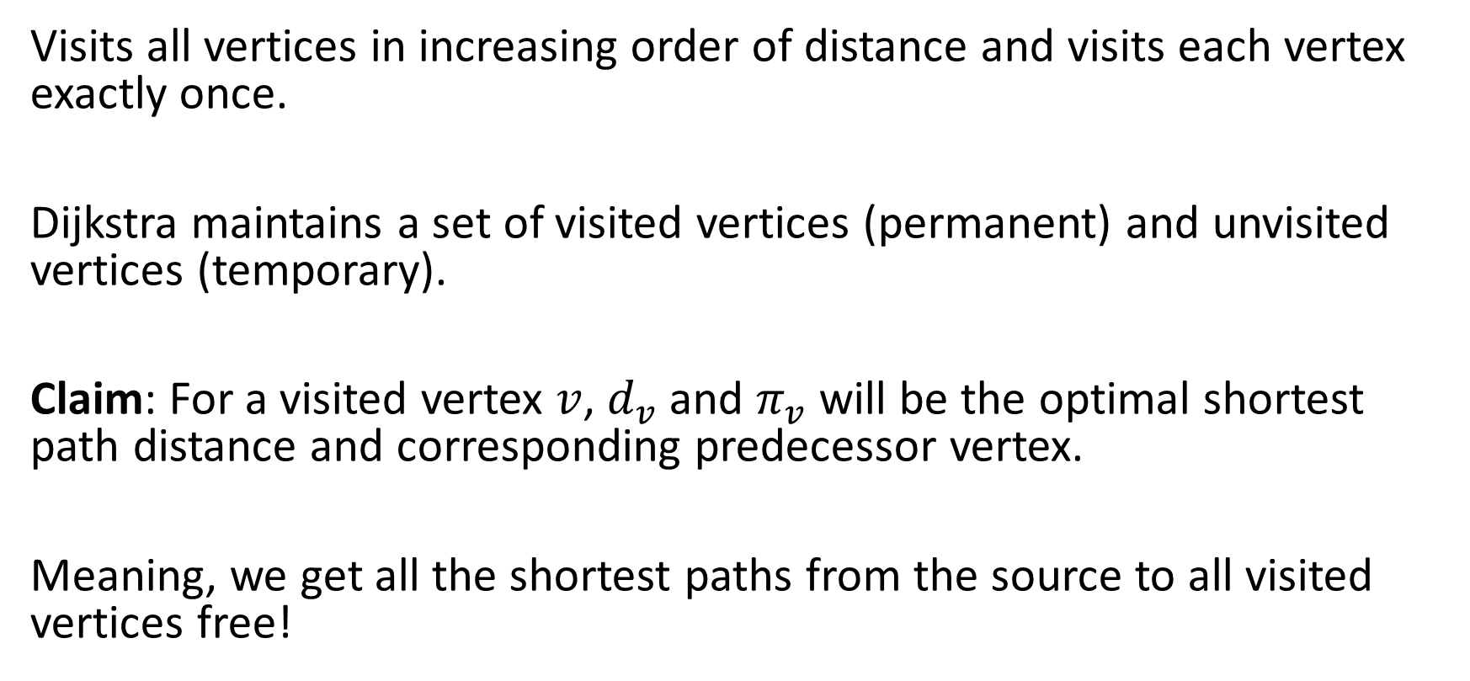
Correctness
Visits all vertices in increasing order of distance and visits each vertex exactly once.
Dijkstra maintains a set of visited vertices (permanent) and unvisited vertices (temporary).
Claim: For a visited vertex $v$, $d_{v}$ and $π_{v}$ will be the optimal shortest path distance and corresponding predecessor vertex.
Meaning, we get all the shortest paths from the source to all visited vertices free!

Slide 30
Shortest sub-path
$$v$$
Permanent
$$v$$
Temporary
d
b
6
17
11
$$v$$ | Label | $$d_{v}$$ | $$π_{v}$$
s | P | 0 | -
b | P | 9 6 | s d
c | P | 17 | b
d | P | 2 | s
e | P | 10 9 | d b
t | P | 15 | e
c
b
9
12
-
3
e
0
s
4
5
t
15
2
1
6
d
e
8
2
9
s
b
For example the shortest path from vertex $s$ to $b$ is $s−d−b$ of length 6

Slide 31
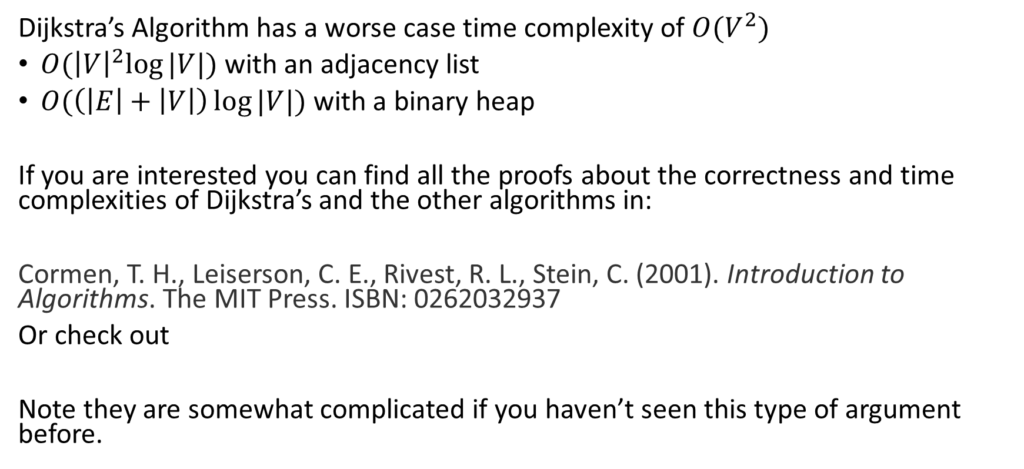
Proof and Time Complexity
The running time depends on how the minimum is found:
$O({\left|V\right|}^{2})$ with a simple array (scan every vertex for the minimum)
$O(\left(\left|E\right|+\left|V\right|\right)\log{|V|)}$ with an adjacency list and a binary heap
If you are interested you can find all the proofs about the correctness and time complexities of Dijkstra’s and the other algorithms in:
Cormen, T. H., Leiserson, C. E., Rivest, R. L., Stein, C. (2001). Introduction to Algorithms. The MIT Press. ISBN: 0262032937
Or check out MIT 6.006 Lecture 16 (Dijkstra) in this week’s 6 Further Reading folder.
Note they are somewhat complicated if you haven’t seen this type of argument before.

Slide 32

30 seconds….
You have 30 seconds to find Wally.
Raise your hand if you find him and I will pause to check.

Slide 33


Slide 34
Checking Answer….
Please be patient, there is some high-tech stuff going on right now…

Slide 36
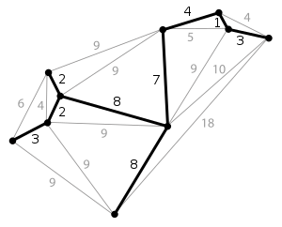
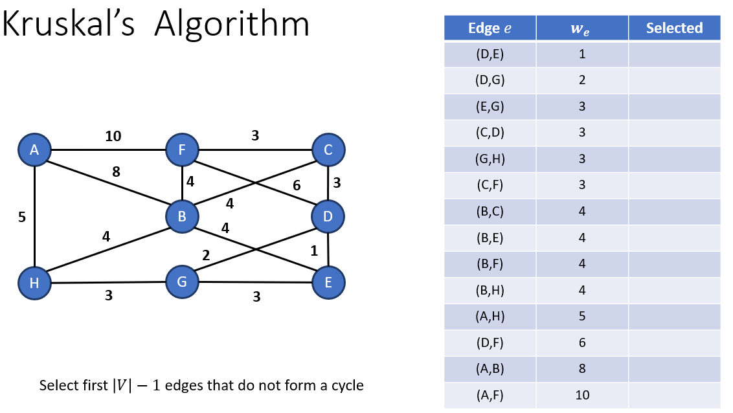
Minimum Spanning Tree
Definition
A subset of weighted edges that connects all the vertices of a connected, weighted, undirected graph together without any cycles and has the minimum total edge weight.
Minimum Spanning Tree

Slide 37
Example Application
A fibre optics company is looking to expand its portfolio by providing broadband to an entirely new set of areas. Currently it has cable laid to a particular location.
The cable is extremely expensive and particularly difficult to lay in certain areas, therefore the company wishes to minimise the cost of laying the cable, whilst connecting all areas.
The company can lay cable between certain areas and has approximated the cost. Compute the minimum cost of connecting all the areas.

Slide 38
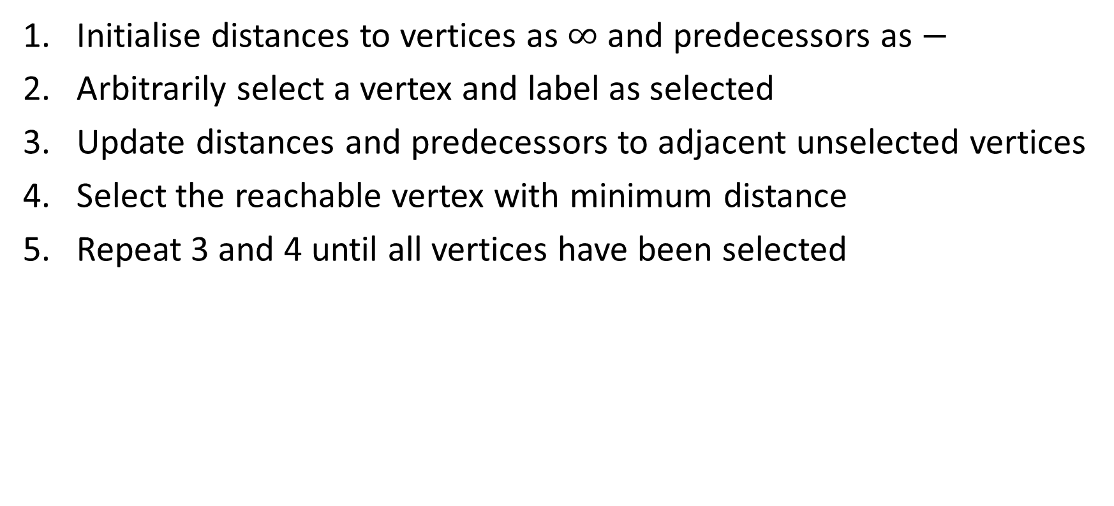
Prim’s Algorithm
Initialise distances to vertices as $∞$ and predecessors as $−$
Arbitrarily select a vertex and label as selected
Update distances and predecessors to adjacent unselected vertices
Select the reachable vertex with minimum distance
Repeat 3 and 4 until all vertices have been selected

Slide 39
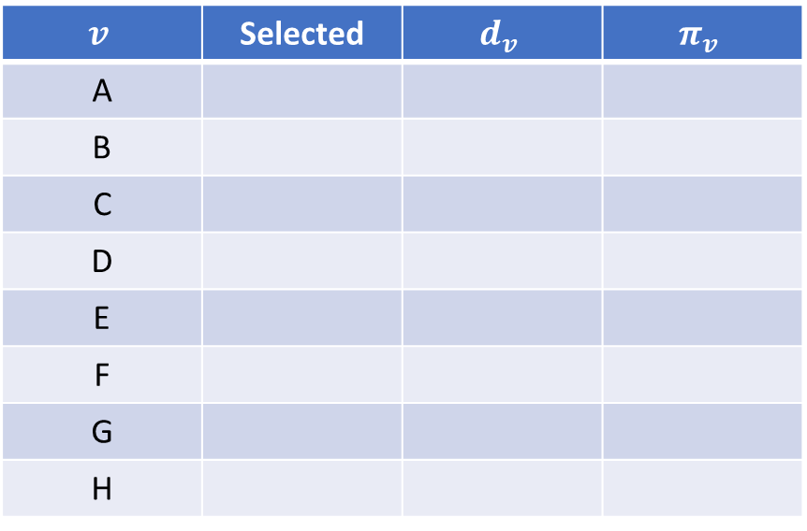
Prim’s Algorithm
Existing Cable
2
$$v$$ | Selected | $$d_{v}$$ | $$π_{v}$$
A
B
C
D
E
F
G
H
10
3
A
F
C
8
7
18
3
B
4
4
D
9
10
2
25
H
G
E
3
7

Slide 40
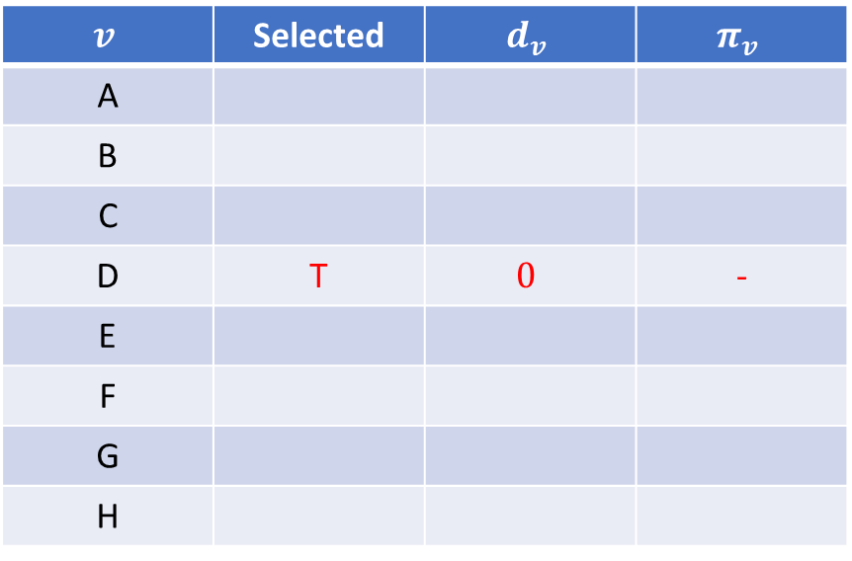
Prim’s Algorithm
2
$$v$$ | Selected | $$d_{v}$$ | $$π_{v}$$
A
B
C
D | T | $$0$$ | -
E
F
G
H
10
3
A
F
C
8
7
18
3
B
4
4
D
9
10
2
25
H
G
E
3
7
Arbitrarily select a vertex and mark as selected (here D; any start vertex gives the same total weight).

Slide 41
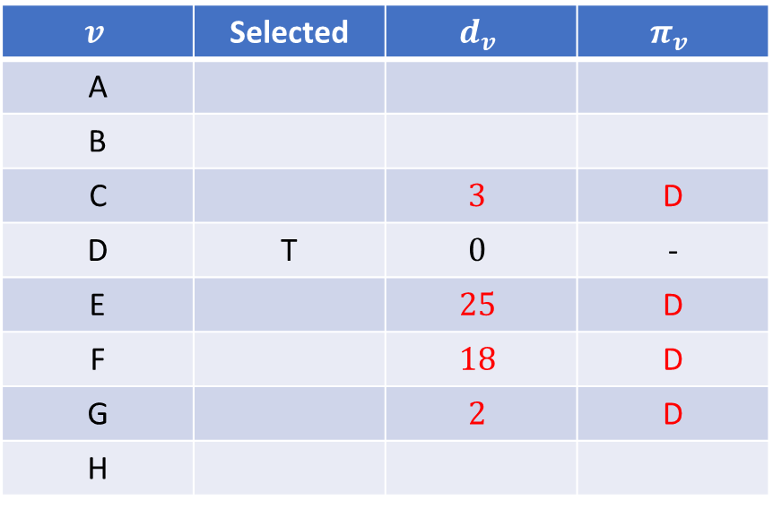
Prim’s Algorithm
2
$$v$$ | Selected | $$d_{v}$$ | $$π_{v}$$
A
B
C |  | $$3$$ | D
D | T | $$0$$ | -
E |  | $$25$$ | D
F |  | $$18$$ | D
G |  | $$2$$ | D
H
10
3
A
F
C
8
7
18
3
B
4
4
D
9
10
2
25
H
G
E
3
7
Update distances of adjacent, unselected vertices

Slide 42
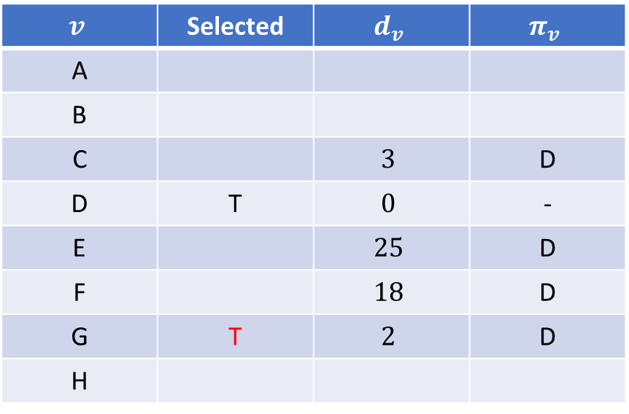
Prim’s Algorithm
2
$$v$$ | Selected | $$d_{v}$$ | $$π_{v}$$
A
B
C |  | $$3$$ | D
D | T | $$0$$ | -
E |  | $$25$$ | D
F |  | $$18$$ | D
G | T | $$2$$ | D
H
10
3
A
F
C
8
7
18
3
B
4
4
D
9
10
2
25
H
G
E
3
7
Select reachable vertex with minimum distance

Slide 43
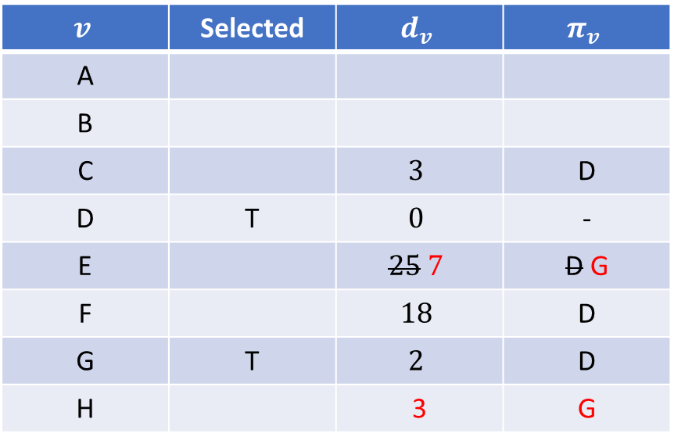
Prim’s Algorithm
2
$$v$$ | Selected | $$d_{v}$$ | $$π_{v}$$
A
B
C |  | $$3$$ | D
D | T | $$0$$ | -
E |  | $$25 7$$ | D G
F |  | $$18$$ | D
G | T | $$2$$ | D
H |  | 3 | G
10
3
A
F
C
8
7
18
3
B
4
4
D
9
10
2
25
H
G
E
3
7
Update distances of adjacent, unselected vertices

Slide 44
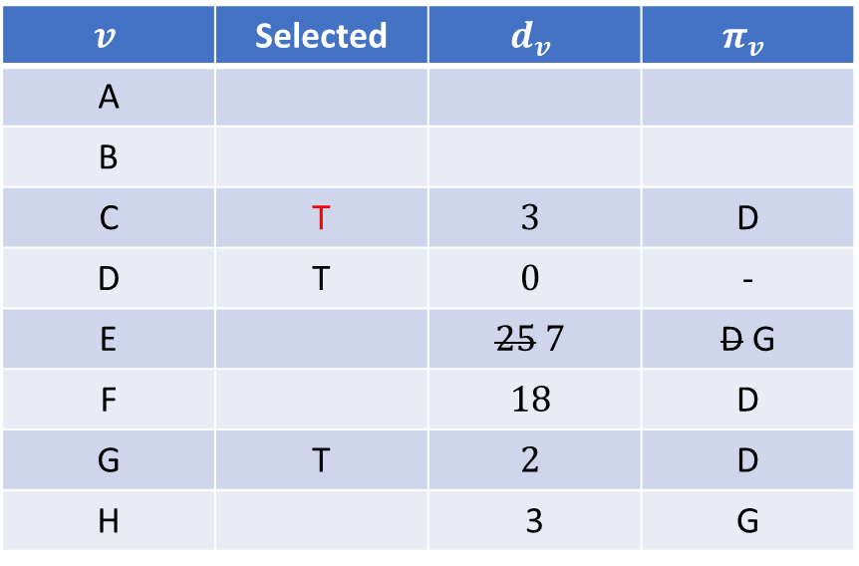
Prim’s Algorithm
2
$$v$$ | Selected | $$d_{v}$$ | $$π_{v}$$
A
B
C | T | $$3$$ | D
D | T | $$0$$ | -
E |  | $$25 7$$ | D G
F |  | $$18$$ | D
G | T | $$2$$ | D
H |  | 3 | G
10
3
A
F
C
8
7
18
3
B
4
4
D
9
10
2
25
H
G
E
3
7
Select reachable vertex with minimum distance

Slide 45
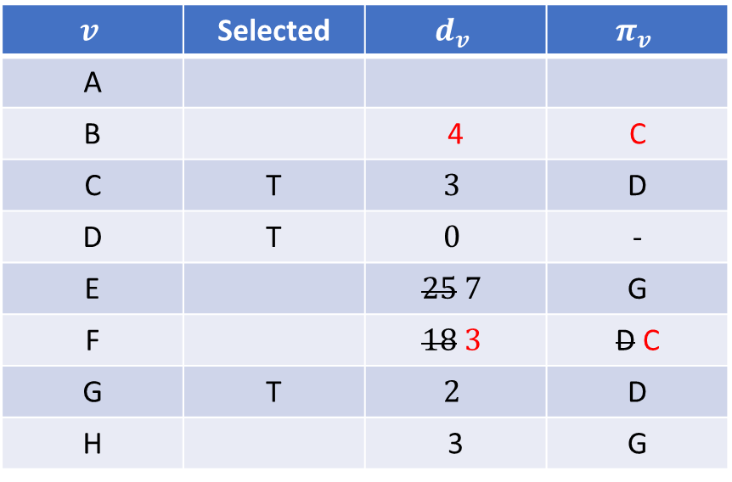
Prim’s Algorithm
2
$$v$$ | Selected | $$d_{v}$$ | $$π_{v}$$
A
B |  | 4 | C
C | T | $$3$$ | D
D | T | $$0$$ | -
E |  | $$25 7$$ | G
F |  | $$18 3$$ | D C
G | T | $$2$$ | D
H |  | 3 | G
10
3
A
F
C
8
7
18
3
B
4
4
D
9
10
2
25
H
G
E
3
7
Update distances of adjacent, unselected vertices

Slide 46
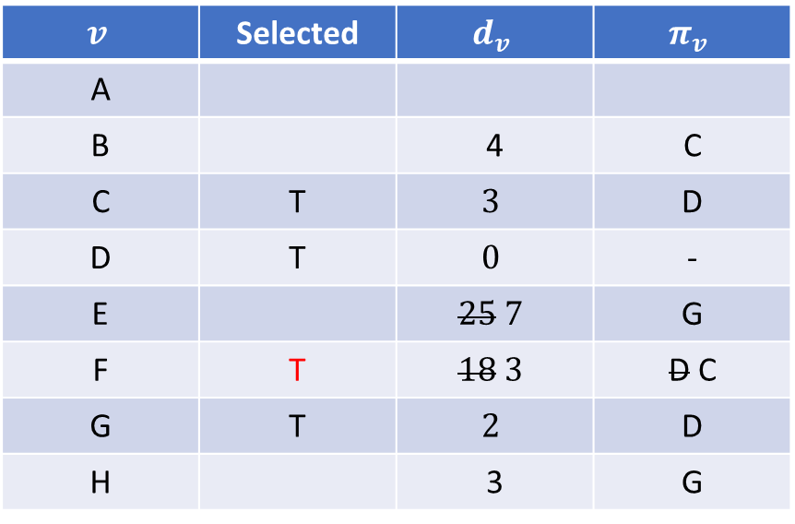
Prim’s Algorithm
2
$$v$$ | Selected | $$d_{v}$$ | $$π_{v}$$
A
B |  | 4 | C
C | T | $$3$$ | D
D | T | $$0$$ | -
E |  | $$25 7$$ | G
F | T | $$18 3$$ | D C
G | T | $$2$$ | D
H |  | 3 | G
10
3
A
F
C
8
7
18
3
B
4
4
D
9
10
2
25
H
G
E
3
7
Select reachable vertex with minimum distance

Slide 47
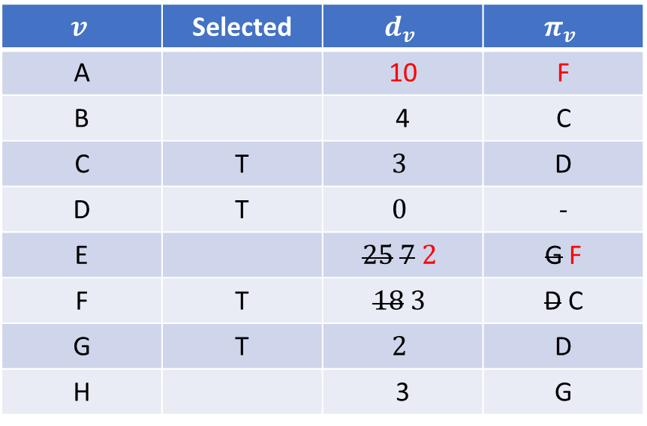
Prim’s Algorithm
2
$$v$$ | Selected | $$d_{v}$$ | $$π_{v}$$
A |  | 10 | F
B |  | 4 | C
C | T | $$3$$ | D
D | T | $$0$$ | -
E |  | $$25 7 2$$ | G F
F | T | $$18 3$$ | D C
G | T | $$2$$ | D
H |  | 3 | G
10
3
A
F
C
8
7
18
3
B
4
4
D
9
10
2
25
H
G
E
3
7
Update distances of adjacent, unselected vertices

Slide 48
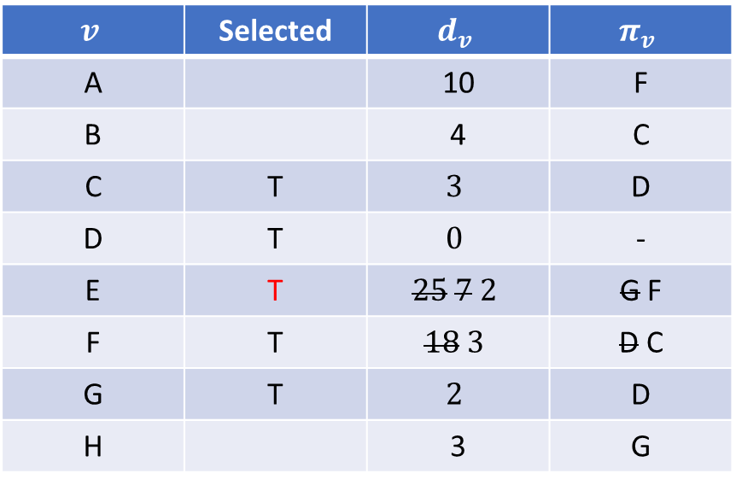
Prim’s Algorithm
2
$$v$$ | Selected | $$d_{v}$$ | $$π_{v}$$
A |  | 10 | F
B |  | 4 | C
C | T | $$3$$ | D
D | T | $$0$$ | -
E | T | $$25 7 2$$ | G F
F | T | $$18 3$$ | D C
G | T | $$2$$ | D
H |  | 3 | G
10
3
A
F
C
8
7
18
3
B
4
4
D
9
10
2
25
H
G
E
3
7
Select reachable vertex with minimum distance

Slide 49
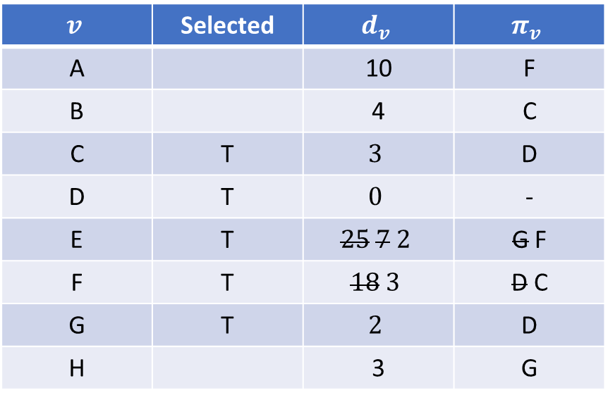
Prim’s Algorithm
2
$$v$$ | Selected | $$d_{v}$$ | $$π_{v}$$
A |  | 10 | F
B |  | 4 | C
C | T | $$3$$ | D
D | T | $$0$$ | -
E | T | $$25 7 2$$ | G F
F | T | $$18 3$$ | D C
G | T | $$2$$ | D
H |  | 3 | G
10
3
A
F
C
8
7
18
3
B
4
4
D
9
10
2
25
H
G
E
3
7
Update distances of adjacent, unselected vertices

Slide 50

Prim’s Algorithm
2
$$v$$ | Selected | $$d_{v}$$ | $$π_{v}$$
A |  | 10 | F
B |  | 4 | C
C | T | $$3$$ | D
D | T | $$0$$ | -
E | T | $$25 7 2$$ | G F
F | T | $$18 3$$ | D C
G | T | $$2$$ | D
H | T | 3 | G
10
3
A
F
C
8
7
18
3
B
4
4
D
9
10
2
25
H
G
E
3
7
Select reachable vertex with minimum distance

Slide 51

Prim’s Algorithm
2
$$v$$ | Selected | $$d_{v}$$ | $$π_{v}$$
A |  | 10 4 | F H
B |  | 4 | C
C | T | $$3$$ | D
D | T | $$0$$ | -
E | T | $$25 7 2$$ | G F
F | T | $$18 3$$ | D C
G | T | $$2$$ | D
H | T | 3 | G
10
3
A
F
C
8
7
18
3
B
4
4
D
9
10
2
25
H
G
E
3
7
Update distances of adjacent, unselected vertices

Slide 52

Prim’s Algorithm
2
$$v$$ | Selected | $$d_{v}$$ | $$π_{v}$$
A | T | 10 4 | F H
B |  | 4 | C
C | T | $$3$$ | D
D | T | $$0$$ | -
E | T | $$25 7 2$$ | G F
F | T | $$18 3$$ | D C
G | T | $$2$$ | D
H | T | 3 | G
10
3
A
F
C
8
7
18
3
B
4
4
D
9
10
2
25
H
G
E
3
7
Select reachable vertex with minimum distance

Slide 53

Prim’s Algorithm
2
$$v$$ | Selected | $$d_{v}$$ | $$π_{v}$$
A | T | 10 4 | F H
B |  | 4 | C
C | T | $$3$$ | D
D | T | $$0$$ | -
E | T | $$25 7 2$$ | G F
F | T | $$18 3$$ | D C
G | T | $$2$$ | D
H | T | 3 | G
10
3
A
F
C
8
7
18
3
B
4
4
D
9
10
2
25
H
G
E
3
7
Update distances of adjacent, unselected vertices

Slide 54

Prim’s Algorithm
2
$$v$$ | Selected | $$d_{v}$$ | $$π_{v}$$
A | T | 10 4 | F H
B | T | 4 | C
C | T | $$3$$ | D
D | T | $$0$$ | -
E | T | $$25 7 2$$ | G F
F | T | $$18 3$$ | D C
G | T | $$2$$ | D
H | T | 3 | G
10
3
A
F
C
8
7
18
3
B
4
4
D
9
10
2
25
H
G
E
3
7
Select reachable vertex with minimum distance

Slide 55


Prim’s Algorithm
2
$$v$$ | Selected | $$d_{v}$$ | $$π_{v}$$
A | T | 10 4 | F H
B | T | 4 | C
C | T | $$3$$ | D
D | T | $$0$$ | -
E | T | $$25 7 2$$ | G F
F | T | $$18 3$$ | D C
G | T | $$2$$ | D
H | T | 3 | G
3
A
F
C
3
B
4
4
D
2
H
G
E
3
All vertices added and we have the minimum spanning tree. $\sum_{v}{d_{v}=21}$

Slide 56
Kruskal’s Algorithm
Order the edges by weightings, lowest to highest
Select the lowest-weight edge not yet considered; if it does not form a cycle, label it as selected
Repeat step 2 until |V| − 1 edges have been selected
A
10
F
3
C
8
4
3
6
This is a cycle
B
4
D
5
4
4
2
1
H
G
E
3
3

Slide 57


Kruskal’s Algorithm
Edge $e$ | $$w_{e}$$ | Selected
(D,E) | 1
(D,G) | 2
(E,G) | 3
(C,D) | 3
(G,H) | 3
(C,F) | 3
(B,C) | 4
(B,E) | 4
(B,F) | 4
(B,H) | 4
(A,H) | 5
(D,F) | 6
(A,B) | 8
(A,F) | 10
10
3
A
F
C
8
4
6
3
B
4
5
D
4
4
2
1
H
G
E
3
3
Select first $\left|V\right|−1$ edges that do not form a cycle

Slide 58

Kruskal’s Algorithm
Edge $e$ | $$w_{e}$$ | Selected
(D,E) | 1 | T
(D,G) | 2
(E,G) | 3
(C,D) | 3
(G,H) | 3
(C,F) | 3
(B,C) | 4
(B,E) | 4
(B,F) | 4
(B,H) | 4
(A,H) | 5
(D,F) | 6
(A,B) | 8
(A,F) | 10
10
3
A
F
C
8
4
6
3
B
4
5
D
4
4
2
1
H
G
E
3
3
Select first $\left|V\right|−1$ edges that do not form a cycle

Slide 59

Kruskal’s Algorithm
Edge $e$ | $$w_{e}$$ | Selected
(D,E) | 1 | T
(D,G) | 2 | T
(E,G) | 3
(C,D) | 3
(G,H) | 3
(C,F) | 3
(B,C) | 4
(B,E) | 4
(B,F) | 4
(B,H) | 4
(A,H) | 5
(D,F) | 6
(A,B) | 8
(A,F) | 10
10
3
A
F
C
8
4
6
3
B
4
5
D
4
4
2
1
H
G
E
3
3
Select first $\left|V\right|−1$ edges that do not form a cycle

Slide 60

Kruskal’s Algorithm
Edge $e$ | $$w_{e}$$ | Selected
(D,E) | 1 | T
(D,G) | 2 | T
(E,G) | 3 | F
(C,D) | 3
(G,H) | 3
(C,F) | 3
(B,C) | 4
(B,E) | 4
(B,F) | 4
(B,H) | 4
(A,H) | 5
(D,F) | 6
(A,B) | 8
(A,F) | 10
10
3
A
F
C
8
4
6
3
B
4
5
D
4
4
2
1
H
G
E
3
3
Forms a cycle!
Select first $\left|V\right|−1$ edges that do not form a cycle

Slide 61

Kruskal’s Algorithm
Edge $e$ | $$w_{e}$$ | Selected
(D,E) | 1 | T
(D,G) | 2 | T
(E,G) | 3 | F
(C,D) | 3 | T
(G,H) | 3
(C,F) | 3
(B,C) | 4
(B,E) | 4
(B,F) | 4
(B,H) | 4
(A,H) | 5
(D,F) | 6
(A,B) | 8
(A,F) | 10
10
3
A
F
C
8
4
6
3
B
4
5
D
4
4
2
1
H
G
E
3
3
Select first $\left|V\right|−1$ edges that do not form a cycle

Slide 62

Kruskal’s Algorithm
Edge $e$ | $$w_{e}$$ | Selected
(D,E) | 1 | T
(D,G) | 2 | T
(E,G) | 3 | F
(C,D) | 3 | T
(G,H) | 3 | T
(C,F) | 3
(B,C) | 4
(B,E) | 4
(B,F) | 4
(B,H) | 4
(A,H) | 5
(D,F) | 6
(A,B) | 8
(A,F) | 10
10
3
A
F
C
8
4
6
3
B
4
5
D
4
4
2
1
H
G
E
3
3
Select first $\left|V\right|−1$ edges that do not form a cycle

Slide 63

Kruskal’s Algorithm
Edge $e$ | $$w_{e}$$ | Selected
(D,E) | 1 | T
(D,G) | 2 | T
(E,G) | 3 | F
(C,D) | 3 | T
(G,H) | 3 | T
(C,F) | 3 | T
(B,C) | 4
(B,E) | 4
(B,F) | 4
(B,H) | 4
(A,H) | 5
(D,F) | 6
(A,B) | 8
(A,F) | 10
10
3
A
F
C
8
4
6
3
B
4
5
D
4
4
2
1
H
G
E
3
3
Select first $\left|V\right|−1$ edges that do not form a cycle

Slide 64

Kruskal’s Algorithm
Edge $e$ | $$w_{e}$$ | Selected
(D,E) | 1 | T
(D,G) | 2 | T
(E,G) | 3 | F
(C,D) | 3 | T
(G,H) | 3 | T
(C,F) | 3 | T
(B,C) | 4 | T
(B,E) | 4
(B,F) | 4
(B,H) | 4
(A,H) | 5
(D,F) | 6
(A,B) | 8
(A,F) | 10
10
3
A
F
C
8
4
6
3
B
4
5
D
4
4
2
1
H
G
E
3
3
Select first $\left|V\right|−1$ edges that do not form a cycle

Slide 65

Kruskal’s Algorithm
Edge $e$ | $$w_{e}$$ | Selected
(D,E) | 1 | T
(D,G) | 2 | T
(E,G) | 3 | F
(C,D) | 3 | T
(G,H) | 3 | T
(C,F) | 3 | T
(B,C) | 4 | T
(B,E) | 4 | F
(B,F) | 4
(B,H) | 4
(A,H) | 5
(D,F) | 6
(A,B) | 8
(A,F) | 10
10
3
A
F
C
8
4
6
3
B
4
5
D
4
4
2
1
H
G
E
3
3
Forms a cycle!
Select first $\left|V\right|−1$ edges that do not form a cycle

Slide 66

Kruskal’s Algorithm
Edge $e$ | $$w_{e}$$ | Selected
(D,E) | 1 | T
(D,G) | 2 | T
(E,G) | 3 | F
(C,D) | 3 | T
(G,H) | 3 | T
(C,F) | 3 | T
(B,C) | 4 | T
(B,E) | 4 | F
(B,F) | 4 | F
(B,H) | 4
(A,H) | 5
(D,F) | 6
(A,B) | 8
(A,F) | 10
10
3
A
F
C
8
4
6
3
B
4
5
D
4
4
2
1
H
G
E
3
3
Forms a cycle!
Select first $\left|V\right|−1$ edges that do not form a cycle

Slide 67

Kruskal’s Algorithm
Edge $e$ | $$w_{e}$$ | Selected
(D,E) | 1 | T
(D,G) | 2 | T
(E,G) | 3 | F
(C,D) | 3 | T
(G,H) | 3 | T
(C,F) | 3 | T
(B,C) | 4 | T
(B,E) | 4 | F
(B,F) | 4 | F
(B,H) | 4 | F
(A,H) | 5
(D,F) | 6
(A,B) | 8
(A,F) | 10
10
3
A
F
C
8
4
6
3
B
4
5
D
4
4
2
1
H
G
E
3
3
Forms a cycle!
Select first $\left|V\right|−1$ edges that do not form a cycle

Slide 68

Kruskal’s Algorithm
Edge $e$ | $$w_{e}$$ | Selected
(D,E) | 1 | T
(D,G) | 2 | T
(E,G) | 3 | F
(C,D) | 3 | T
(G,H) | 3 | T
(C,F) | 3 | T
(B,C) | 4 | T
(B,E) | 4 | F
(B,F) | 4 | F
(B,H) | 4 | F
(A,H) | 5 | T
(D,F) | 6
(A,B) | 8
(A,F) | 10
10
3
A
F
C
8
4
6
3
B
4
5
D
4
4
2
1
H
G
E
3
3
|V| − 1 = 7 edges selected. Stop
Select first $\left|V\right|−1$ edges that do not form a cycle

Slide 69


Kruskal’s Algorithm
Edge $e$ | $$w_{e}$$ | Selected
(D,E) | 1 | T
(D,G) | 2 | T
(E,G) | 3 | F
(C,D) | 3 | T
(G,H) | 3 | T
(C,F) | 3 | T
(B,C) | 4 | T
(B,E) | 4 | F
(B,F) | 4 | F
(B,H) | 4 | F
(A,H) | 5 | T
(D,F) | 6 | F
(A,B) | 8 | F
(A,F) | 10 | F
3
A
F
C
3
B
4
5
D
2
1
H
G
E
3
$\left|V\right|−1$ edges selected, let $T$ be the edges in the MST, then
$$\sum_{e∈T}{w_{e}=21}$$

Slide 70
References
Cormen, T. H., Leiserson, C. E., Rivest, R. L., Stein, C. (2001). Introduction to Algorithms. The MIT Press. ISBN: 0262032937
Taha, H. A. (2017). Operations Research: An Introduction (10th ed.). Pearson.

